Slide 1


Title I Annual Parent Meeting
Belcher Elementary
8/31/22
5:00
Media Center
Dawn Lewis, Principal
Stephanie Blackman, AP
Brittany Lee, MTSS
Notes:
Evidence: Upload completed presentation and recorded feedback as part of the evidence to support the Annual Meeting Materials. Do not forget the sign-in sheets, and survey/feedback that you receive throughout the meeting.

Slide 2

All About Title I
Title I is the largest federal assistance program for our nation’s schools.
The program serves 75 schools in Pinellas County including eligible students in 36 non-public schools.
Notes:
Highlight the Title I Program here in Pinellas County.

Slide 3
Title I Funding Process
Pinellas County Schools
Increased Student Achievement
Federal Government
1
3
2
4
Florida Department of Education
Belcher Elementary
Notes:
The Florida Department of Education receives funds from the federal government. Districts receive Title I funds from Department of Education, and the school district distributes these funds to schools based on the percentage of children eligible for free/reduced price lunch; however, students do not have to be from low-income families to receive help.

Slide 4

Supplemental Resources
Definition: provided in addition to what is already present or available to complete or enhance it.
https://languages.oup.com/
Notes:
Title I is supplemental federal funding that provides money to supplement what is provided to all schools
Definition: provided in addition to what is already present or available to complete or enhance it extra academic support and learning opportunities for economically disadvantaged students.

Slide 5
Title I Programs Provide Supplemental Support
  Title I MTSS Coach
  Title I funded Interventionist
  Title I hourly teachers
  Classroom supplies and resources
  Parent Engagement Events
  ELP Program
Notes:
Use additional slides if necessary. This is where you want to really highlight Title I funding and how it positively impacts your scholars!

Slide 6
Let’s Celebrate!
Last year Belcher focused it’s funding on
k-2 for hourly support and vpk-5 for classroom materials
The result…Belcher earned a B!
Notes:
Based on the FSA data and school grades, there is a lot to celebrate!!

Slide 7
Title I Schoolwide Planning and Input
First
Second
Last
Seek Input from school, family, and community members determine how Title I funds are used based on a needs assessment.
Please attend online or in-person meetings/trainings and complete surveys to provide input on Title I funding.
All Title I schools must document that parents are involved in the schoolwide planning process.
Notes:
This is why it is SO important to fill out the Title 1 surveys to give families voice.
Evidence for input – input from school can be a survey or notes, which include quotes related to what was shared as feedback AND how this input will be used to inform the PFEP and future engagement activities.
Evidence of Attendance – please include attendance of DIVERSE stakeholder group/s.

Slide 8

Title I Schoolwide Budget
Belcher Elementary is provided 181,436.00 to pay for supplemental resources and programs for increased student achievement.
20% Two Part time hourly teachers
30% Fulltime instructional interventionist
40% instructional coach
10% instructional materials

Slide 9

Parent’s Right to Know
As a parent of a student attending a Pinellas County School Public School, you have the right to…
Be
Be provided information on your child’s level of achievement on assessments in Reading/Language Arts, Writing, Mathematics, and Science.
Request and Receive
Request and receive information on the qualifications of your child’s teacher and supplemental personnel working with your child.
Be
Be notified of non-highly qualified or out-of-field teachers at the school.
Be
Be informed if your child is taught by a non-highly qualified teacher for four or more consecutive weeks.
Notes:
Assessment feedback is in parent Focus
Teachers need to be certified in their content area and it is the responsibility of the school to notify parents if they are not qualified

Slide 10
Working Together for Student Success
As a Title I parent you have the right to be involved in the development of the following plans and documents for our school which can be found on our website to view as well as in the Parent Station located in the front office.
School Improvement Plan (SIP)
Title I Schoolwide Plan
Parent and Family Engagement Plan (PFEP)
School-Parent-Student Compact
Notes:
Our school’s Title I Parent Station is located (insert location or photo of Title I Parent Station (front office and on the webpage). Please include photo as part of the evidence monitoring.
You will find a copy of our School Improvement Plan, Title I Schoolwide Plan, School’s PFEP, the School District’s PFEP, Parent’s Right to Know Memo, Upcoming Events, Compact, (insert other documents at your station)

Slide 11

Parent-School-Student Compact
The purpose of the compact is to foster student achievement. By signing the Parent-School-Student Compact, (Insert name of school here), teachers, staff, parents and students agree to work together to share the responsibility of helping students meet or exceed state, district and school academic goals.
The Parent-School-Student Compact is updated every year to include parent, student, teacher, and staff input. Parent, student, teacher and staff comments are welcome at any time during the year.
Please review and sign your child’s Compact.
Our goal is to receive 100% signed compacts!
Notes:
At the elementary level, school compacts are used as a progress monitoring tool through the year during parent teacher conferences.

Slide 12

Notes:
Highlight any things that unique to your school’s compact.

Slide 13

Parent and Family Engagement Plan (PFEP)
The PFEP Sections include information about the following:
  Curriculum and Family Involvement Nights
  ESOL Information Sessions and conferences with teachers
  Connect Ed Calls, school website, and Class Dojo
  Virtual and on campus meeting options
Notes:
Provide information on the specific committees that parents can be involved. Include the purpose, date and time of meetings.
Explain the PFEP and its purpose.
SAC and PTA
Consider the evidence related Title I Crate, Sample of Evidence,
Class Dojo
Virtual and on campus meeting options
School Messenger messages, school marquee, and posting on school website
ESOL Information Sessions
Curriculum and Family Involvement Nights

Slide 14
Parent Advisory Council (PAC)
The District has a Parent and Family Engagement Plan. The summary of the plan is in the Title I School & Family Partnership Overview.
You may access the full plan at www.pcsb.org/titleone
The Parent Advisory Council (PAC) is responsible for reviewing and revising the District PFEP.
PAC will meet virtually or in-person with the district’s Title I staff.
Each school is committed to having at least one member representative on PAC.
PAC meets twice a year, if you are interested in representing our school please notify, Stephanie Blackman at blackmans@pcsb.org
Notes:
Please add your PAC representative in slide and share with your Title I Specialist.

Slide 15
Recruitment Video: We Want you !
Parent Advisory Council (PAC) Video
Notes:
Please play the 1-minute video to share with families about the PAC and the interest form (which is on the next slide).

Slide 16
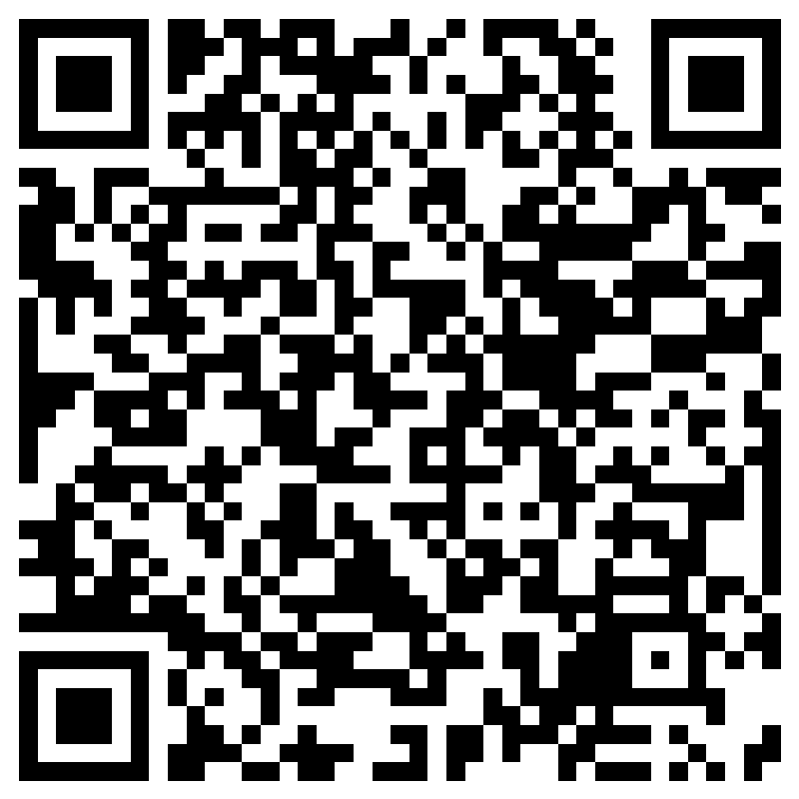
Parent Advisory Council (PAC) Interest Form
Notes:
Please complete the form if you are interested in representing your school/community.
Please allow a minute for interested families to complete the form during the meeting.
Here is the link for you to share also: https://forms.office.com/r/XYv54tECMy

Slide 17

Accountability
  School Report Cards
  School Grade and Overview
  Population and Enrollment
  Assessments – Academic Achievement, Growth, and Population
  Assessments – English Language Learners
  Graduation and Beyond
  Educator Qualifications and Equity
  Long-Term Goals and Interim Progress
  Accelerated Course Enrollment
  Per-Pupil Expenditures
  National Data
  Available online at https://edudata.fldoe.org/ or Front Office

Slide 18

Working Together for Student Success
Please join us at SAC or PTA
Notes:
Do you have a calendar of key events that are included in your PFEP.
Evidence – Consider this as evidence to include to support Family Engagement.
The SAC determines the goals in the plan and how progress toward the goals will be measured.
The Belcher Elementary School Advisory Council (SAC) is a team of people representing various segments of the community: parents, teachers, students, administrators, support staff, business/industry people and other interested community members. The SAC is responsible for strategic planning for the school improvement plan and working jointly with the principal and staff after analyzing relevant data.

Slide 19
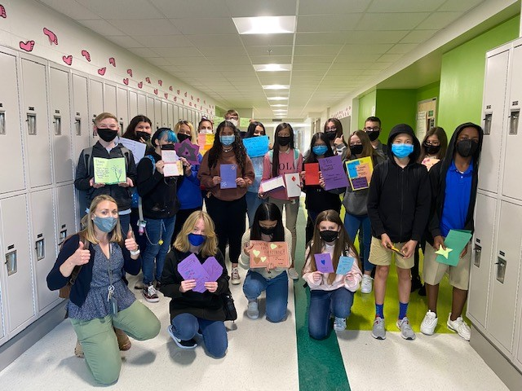

Additional Resources
Learning at Home Family Resources - https://www.pcsb.org/Page/32836
Volunteer in a Pinellas County School - https://www.pcsb.org/Page/459
Parent Academy POWER HOURS Webinars - https://www.pcsb.org/Page/26534
Partnerships - https://www.pcsb.org/Page/418
Notes:
We are busy getting new and relevant workshops lined up to assist our families in this new journey. Look forward to a series of POWER HOUR online workshops on the following important topics. All webinars will be recorded and posted in the resource section below for viewing.

Slide 20
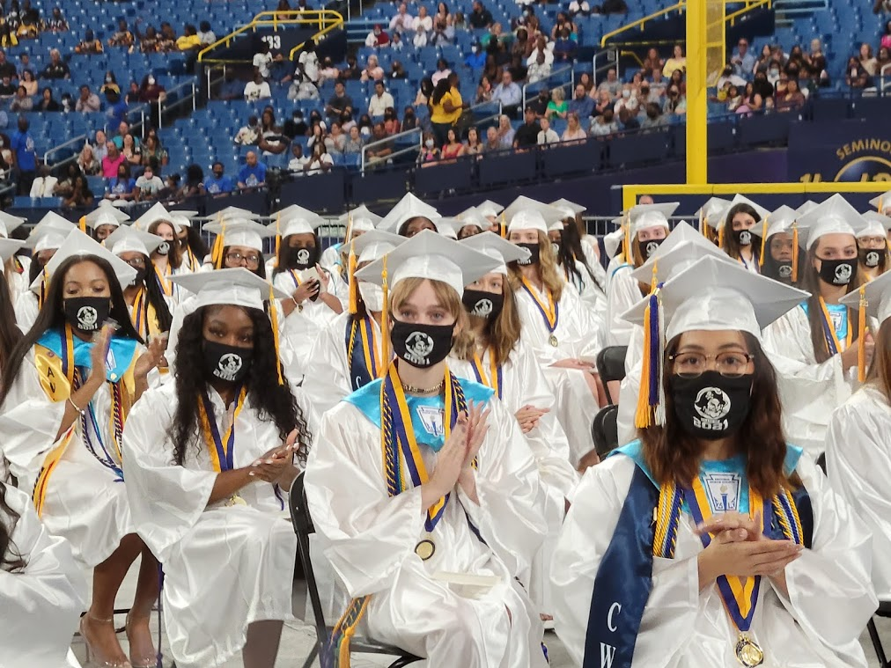
We appreciate your time!
Please feel free to ask any questions and provide feedback on our Title I Program.

Slide 21
Contact Us
Dawn Lewis, Principal
Stephanie Blackman, AP
Brittany Lee, MTSS Coach
727-538-7437
Lewisda@pcsb.org
Blackmans@pcsb.org
Leebr@pcsb.org

Slide 22
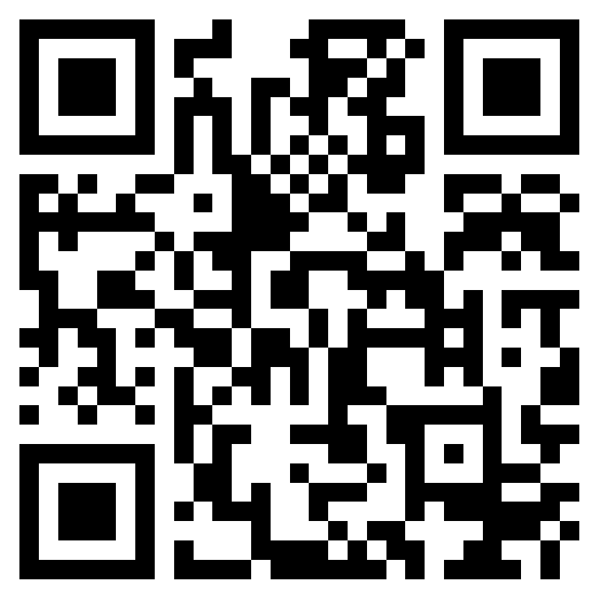
Please take the time to participate in our survey.
Scan the QR
Your feedback is greatly appreciated!
Notes:
Please duplicate Microsoft Forms provided or create school survey. To generate a QR code hover over your school’s survey and and right click. Create QR code for this page will be an option.
https://forms.office.com/Pages/ShareFormPage.aspx?id=BZM8c9c5GkaGb_3ye_PH_x-1YNVO6C1FkgA88U6PR2tUNEQzTU0wNkZXVUxVTlpEMU81NkJFMlJNTi4u&sharetoken=FXXhmgwFjSnl0sNz61ki
Quick 6 question survey

